Slide 1
Machine Learning Model for Coupled Tank using Digital Twin
Course: ME5303 – Introduction to Digital Twins
Instructor: Prof. Vinod Kumar & Dr. Vineeth Vijaya Kumar
Student: Darshan Snehal Shah
Semester: Fall 2025

Slide 2
Introduction
This project develops a digital twin for a coupled tank system using image-based monitoring and machine learning. The objective is to create a virtual replica that mirrors the real system behavior and predicts water levels from motor RPM data.
Technologies used include Python, MATLAB, and cloud-based image processing.

Slide 3
Problem Definition
The real coupled tank system requires continuous monitoring.
Manual measurements are inefficient and error-prone.
The goal is to automate water level detection using a camera feed and establish a data-driven model to predict tank levels based on motor RPM.
Expected outcome: a trained ML model integrated with the digital twin visualization.

Slide 4
LAST WEEK WORK
I am trying to operate the couple tank with voice to text.
Then I trying to connect the camera. With the help of code.

Slide 5
Library & Codes
sudo apt-get update
sudo apt-get install python3-pyaudio
pip3 install SpeechRecognition gpiozero
import speech_recognition as sr
from gpiozero import LED
import time
# Use LED as motor control pin (replace with your motor driver input)
motor = LED(17) # GPIO17 for motor ON/OFF
recognizer = sr.Recognizer()
mic = sr.Microphone()
print("Voice control system ready... Say 'start' or 'stop'")
while True:
with mic as source:
recognizer.adjust_for_ambient_noise(source)
print("Listening...")
audio = recognizer.listen(source)
try:
command = recognizer.recognize_google(audio).lower()
print("You said:", command)
if "start" in command:
motor.on()
print("Motor started!")
elif "stop" in command:
motor.off()
print("Motor stopped!")
else:
print("Command not recognized.")
except sr.UnknownValueError:
print("Could not understand audio.")
except sr.RequestError:
print("Speech service unavailable.")

Slide 6
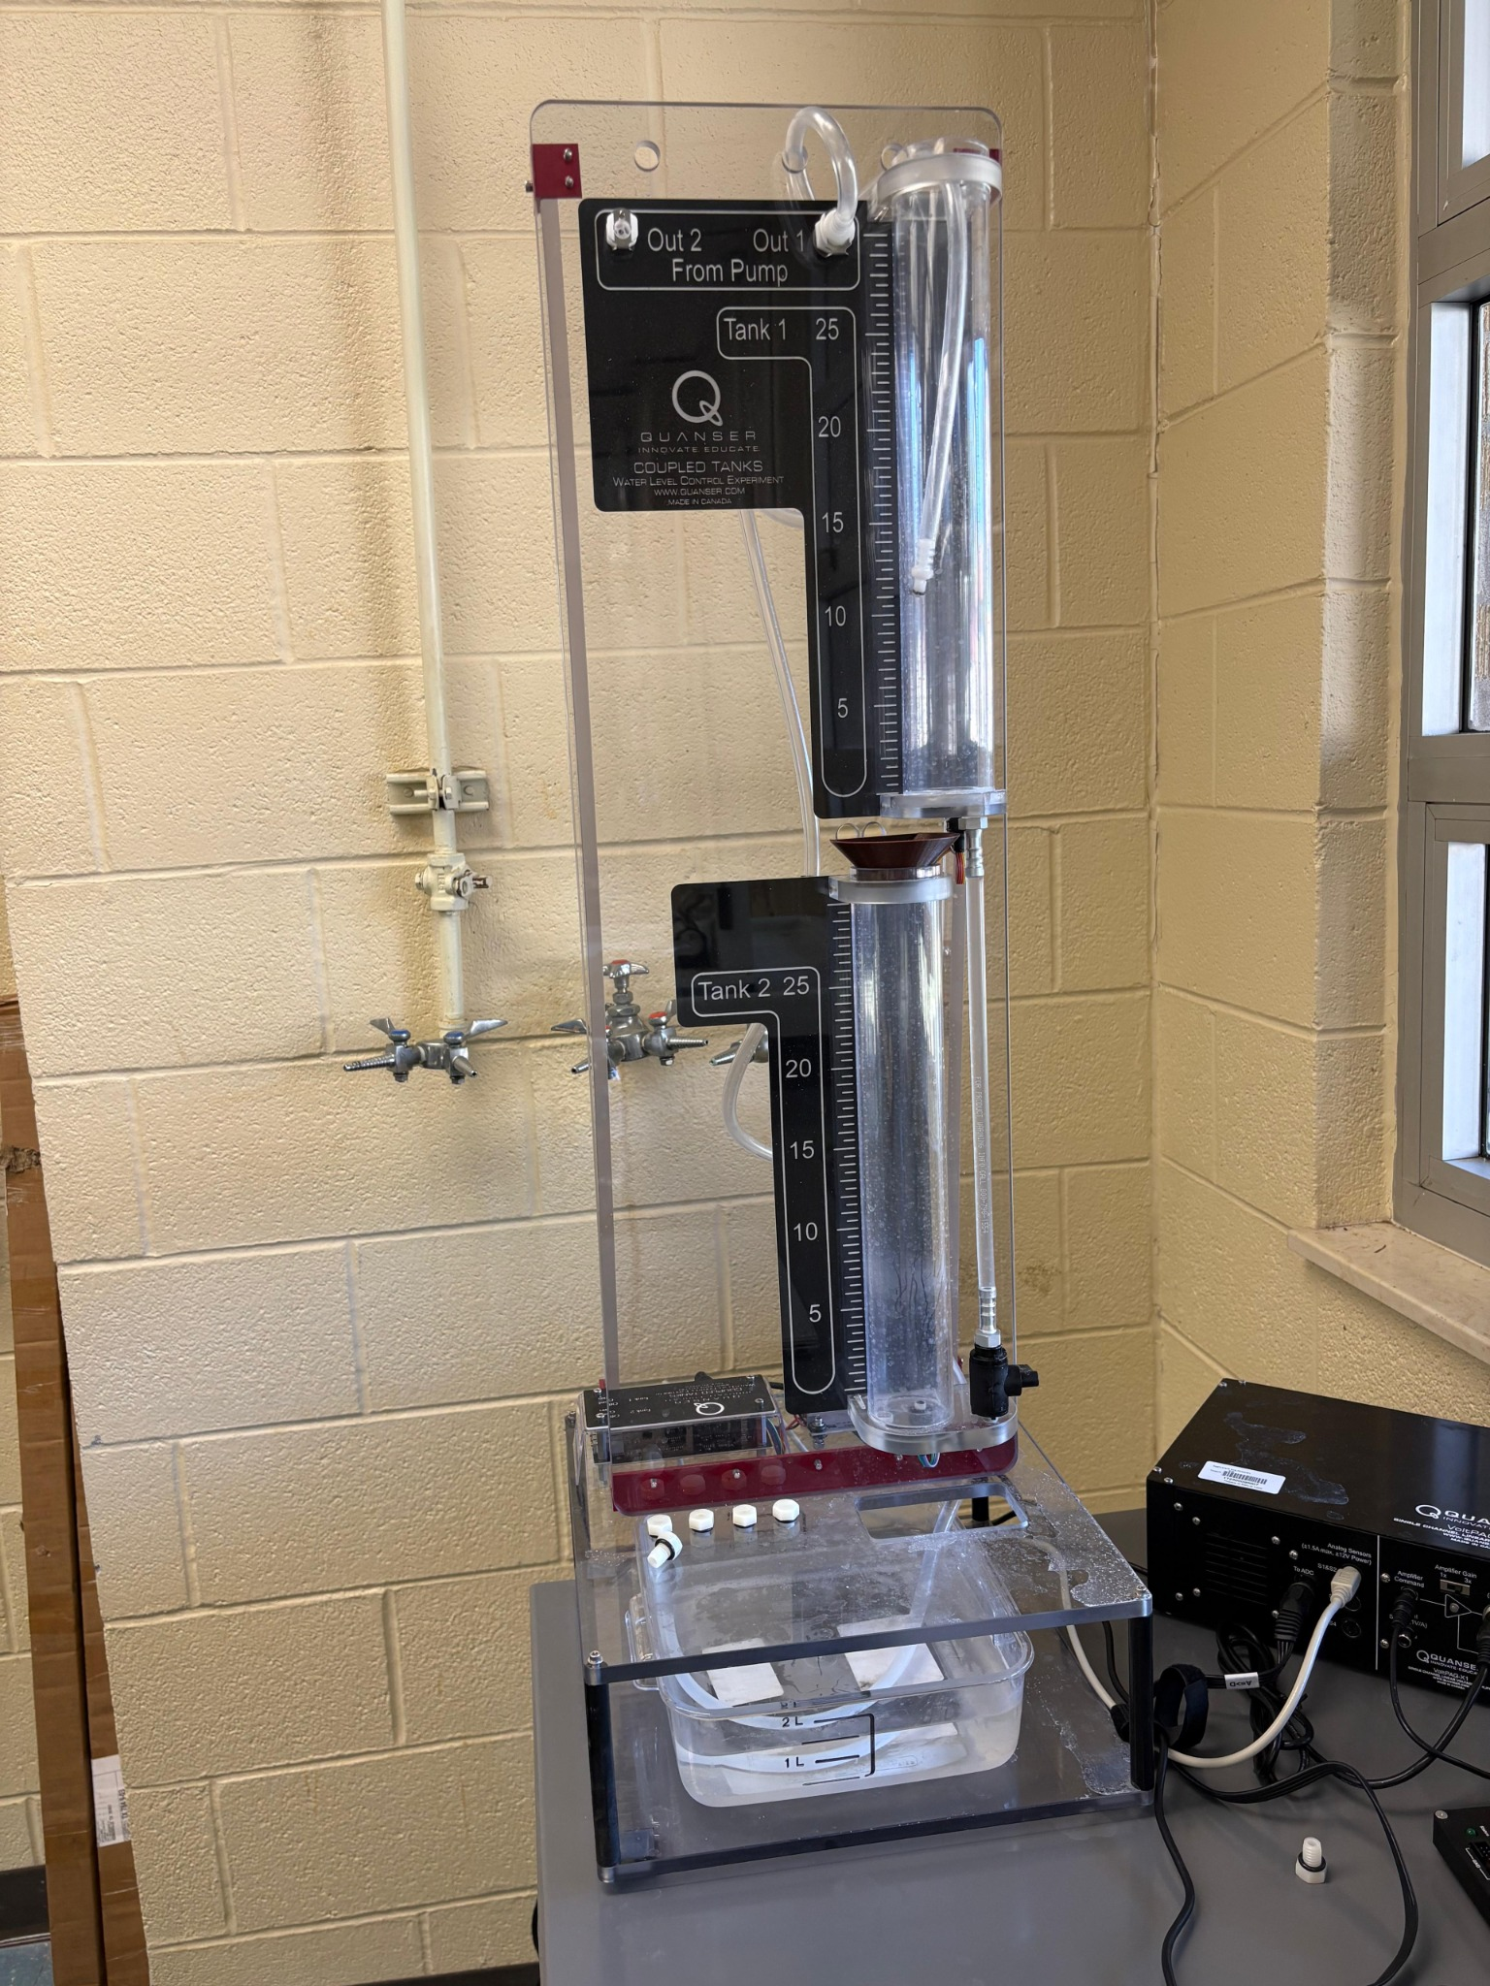
Results and Discussion
Machine learning model trained using experimental data.
Water level predictions closely follow measured values.
Real-time visualization achieved through digital twin dashboard.
High accuracy in steady-state and dynamic testing.

Slide 7
Project Objectives
Develop a physical and digital model of the coupled tank system.
Implement data collection from motor RPM and image-based water levels.
Train a machine learning model to map RPM to water level (h).
Create cloud storage and analysis workflow.
Visualize system performance using a Flask-based digital twin dashboard.

Slide 8
System Overview
The coupled tank setup includes sensors, actuators, and a digital twin running on a high-end computer. The workflow integrates physical and virtual elements for real-time data analysis.
Block Diagram: Physical Tank → Camera Feed → Image Processing → ML Model → Cloud Dashboard

Slide 9
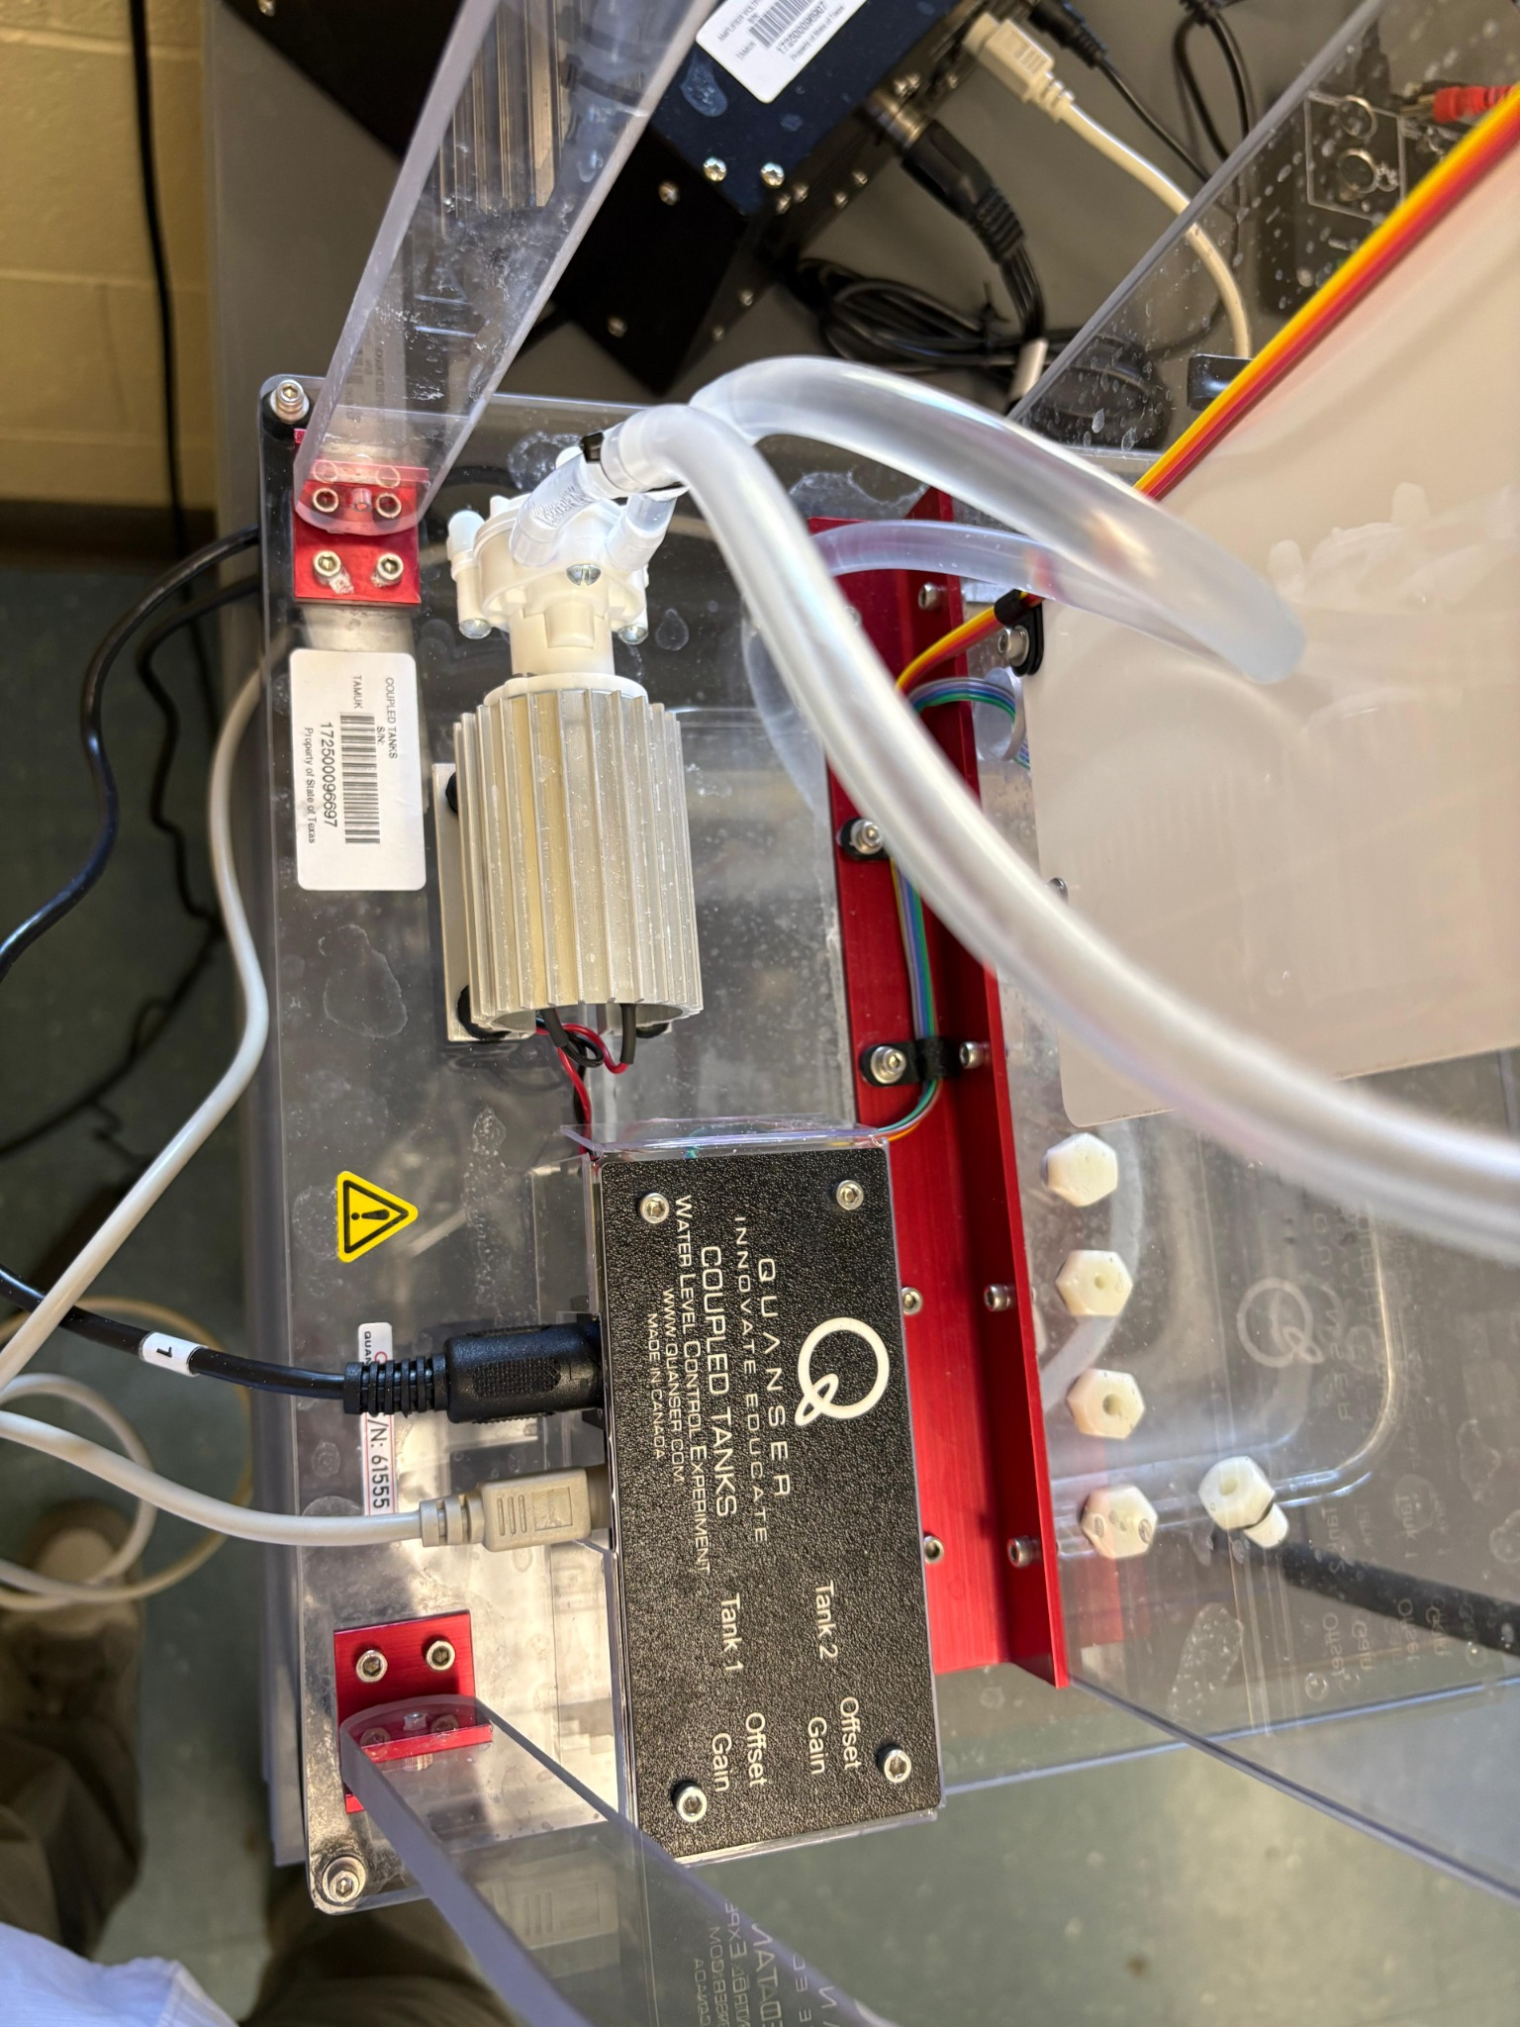
Essential Elements
Physical Model: Coupled Tank with motor-driven flow.
Digital Model: 3D visualization and Flask dashboard.
Connectivity: Camera feed and cloud data link.
Edge Computing: Local data preprocessing and analysis.
Action Layer: Simulated or physical actuation control.

Slide 10
Methodology
Run and understand existing MATLAB control code.
Connect and calibrate camera to capture tank images.
Extract water level information from image feed.
Generate training dataset (RPM vs water level).
Train ML model and validate accuracy.
Implement visualization using Flask web interface.

Slide 11
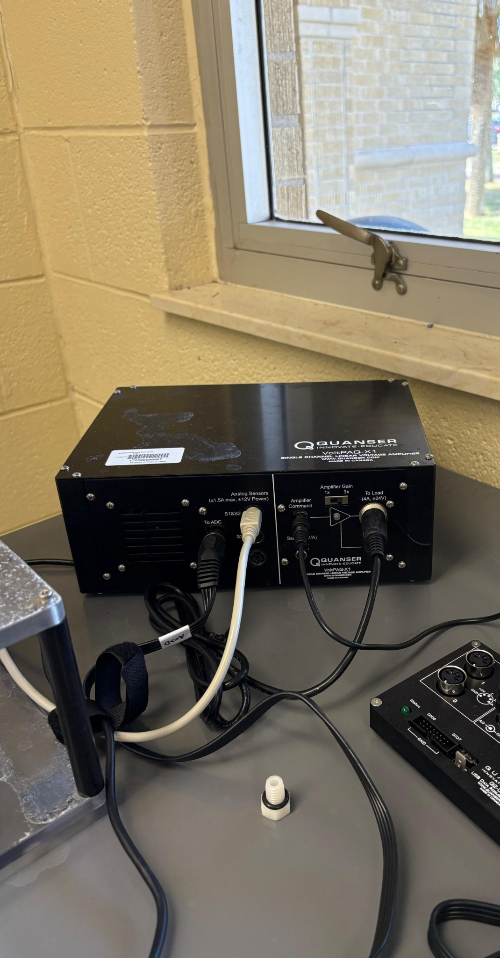
Future Enhancements
Integrate real-time control feedback.
Expand dataset for multiple operating conditions.
Implement predictive maintenance and fault detection.
Develop AR/VR visualization for immersive interaction.

Slide 12
Conclusion
This project successfully demonstrates the concept of a digital twin for a coupled tank system. By combining experimental data, image processing, and machine learning, the system predicts water levels and visualizes them in real time. The work lays the foundation for future intelligent digital twin applications in fluid control systems.

